Slide 1

Building a Custom Sentiment Lexicon from a Ratings Dataset
David Brock
Data Science for Social Good REU

Slide 2
Introduction
A Sentiment Lexicon
Assigns a numeric score to words
Is useful for classifying text
reviews, tweets, comments, etc.
Not usually task specific
“This is a super interesting presentation!!!” 0.65
“This is the most boring presentation ever!” -0.25
Goal: A Task Specific Lexicon
Terrible
Bad
Mediocre
Good
Excellent
-1
0
1

Slide 3
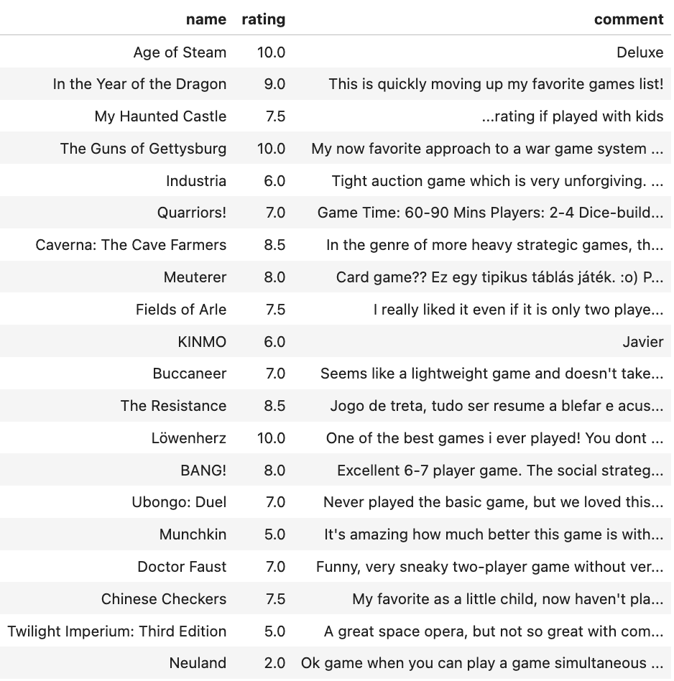
Dataset
Kaggle - BoardGameGeek Reviews
3,368,619 reviews with comments
18,964,807 total reviews
Average comment is 38 words
Ratings range from 0-10
Average is 6.9

Slide 4
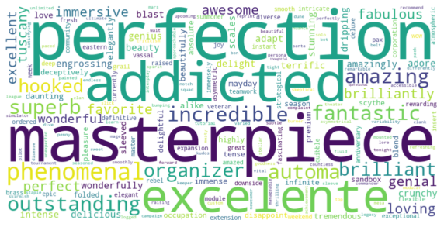
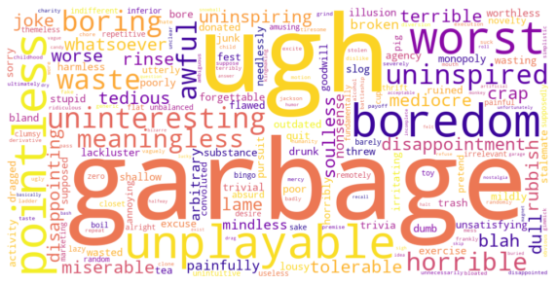
Analysis
Positive Words
Clean text
Remove stopwords, lemmatize, etc.
Exclude words in < 1000 reviews
Normalize ratings to [-1, 1]
Compute average rating
Weighted by occurrences in comment
Negative Words
“It is boring.” -0.01
“The game is a masterpiece!” 0.75

Slide 5
Conclusions
Custom sentiment lexicon
Board Games
Perfection, masterpiece - best things to say
Garbage, ugh – worst things to say
Next steps
“de-skew” data?
Other scoring methods
Context dependent methods
Test other datasets

Slide 6
Questions?
?
?
?
?
?
?
?
?
?
?
?
?
?
?
?
brockd@mail.smu.edu

